Slide 1
Census Income
By
Gopalakrishnan Kumar

Slide 2
Objectives
To perform a predictive task of classification to predict whether an individual makes over 50K a year or less using machine learning algorithms

Slide 3
Data Preparation
Census Dataset was provided with variables such as age, work-class, education, no of years of education, marital status, occupation and relationship.
Lab environment- R Studio
Domain Social

Slide 4
Data Preprocessing
All the missing values are replaced with NA.
All the rows that contains NA values are removed
All whitespaces from the columns are removed

Slide 5
Data Manipulation
To analyze the dataset, various functions from the dplyr package

Slide 6
Data Visualization
Helps to understand patterns, trends and outliers in dataset.
In this project, data visualization has been performed in the form of
Bar graph
Histogram
Scatterplot
Boxplot

Slide 7
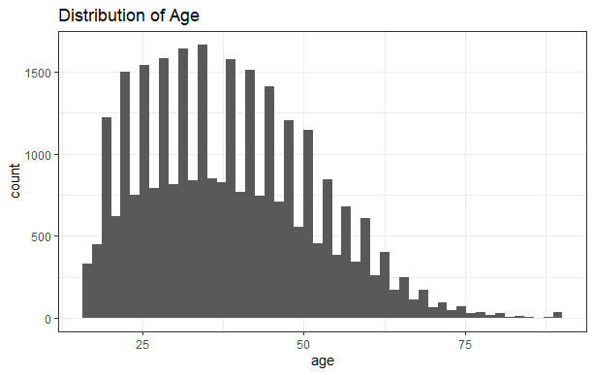
Bar Graph

Slide 8
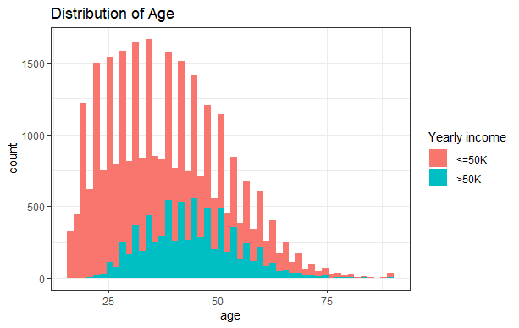
Bar Graph

Slide 9
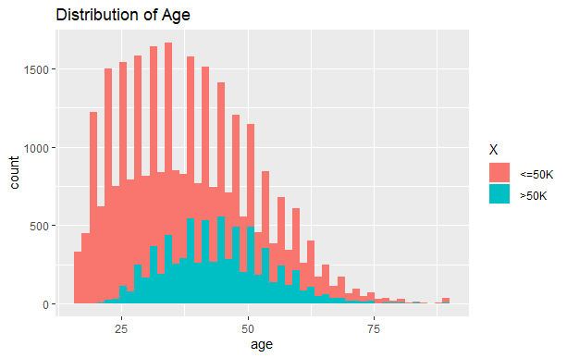
Bar Graph

Slide 10
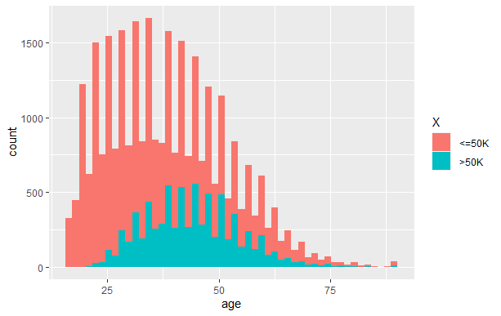
Bar Graph

Slide 11
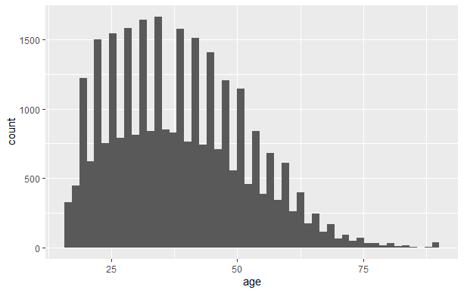
Bar Graph

Slide 12
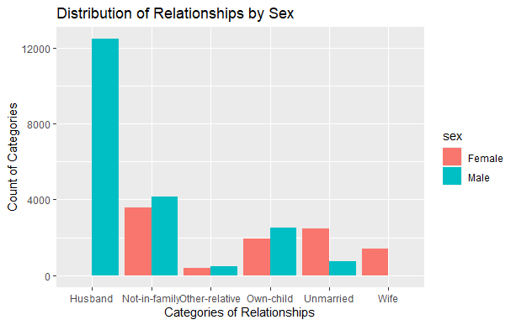
Histogram

Slide 13
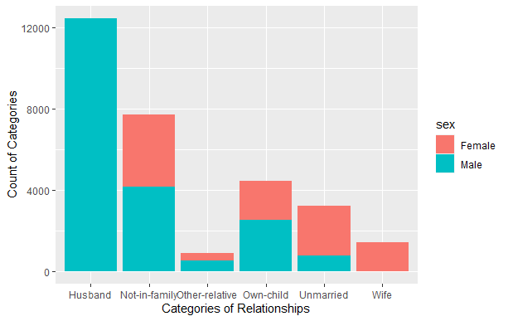
Histogram

Slide 14
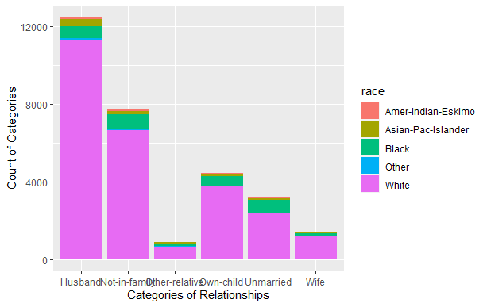
Histogram

Slide 15
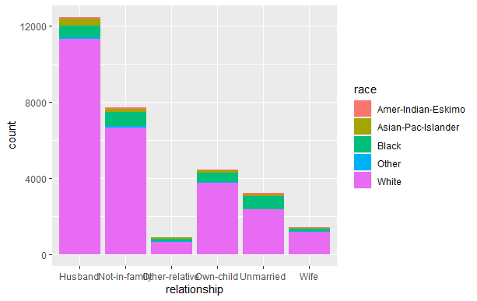
Histogram

Slide 16
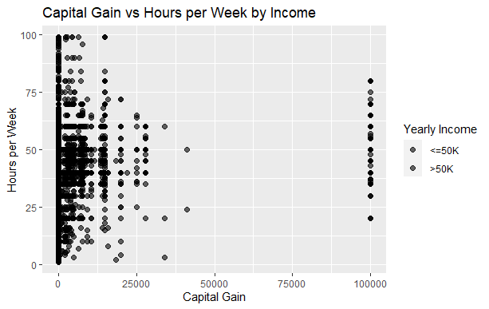
Scatterplot

Slide 17
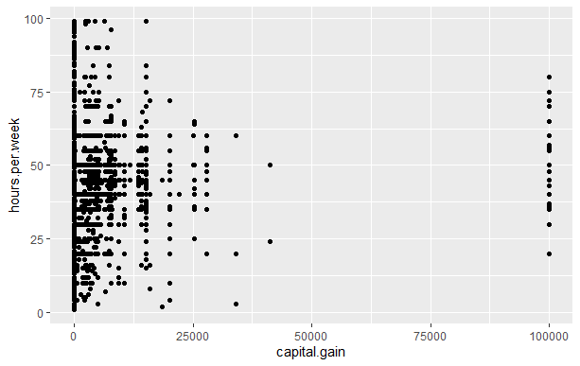
Scatterplot

Slide 18
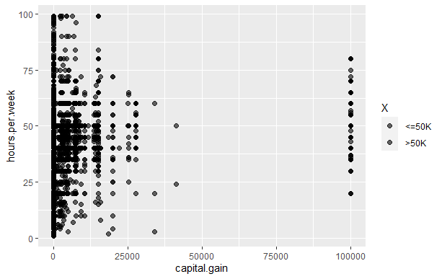
Scatterplot

Slide 19
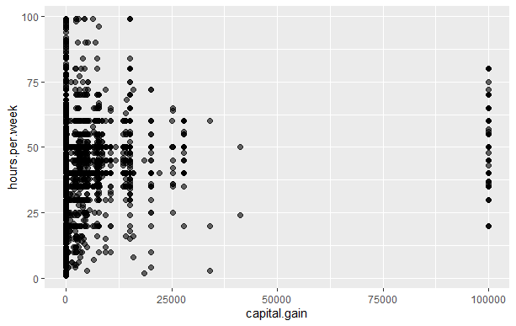
Scatterplot

Slide 20
Scatterplot

Slide 21
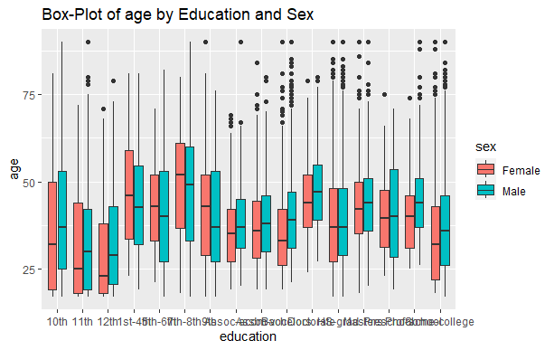
Boxplot

Slide 22
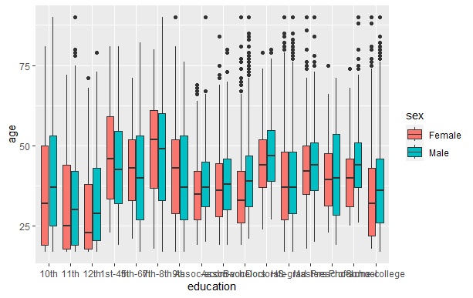
Boxplot

Slide 23
Boxplot

Slide 24
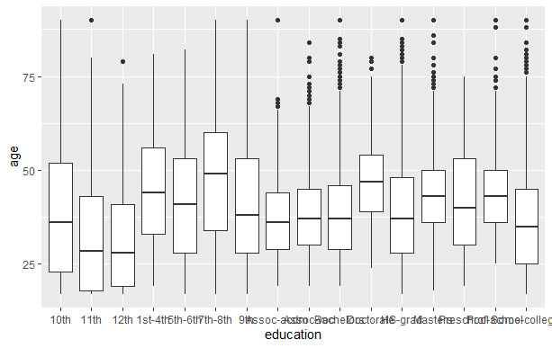
Boxplot

Slide 25
Model Building
Decision Tree model has been applied to predictive task of classification to predict whether an individual makes over 50K a year or less
Dataset has been divided into training and testing sets in 70:30
A Decision Tree model was built with dependent variable as yearly income (X-axis) and the rest of variables as independent variables
The values are predicted on the test set
Confusion has been built to calculate the accuracy

Slide 26
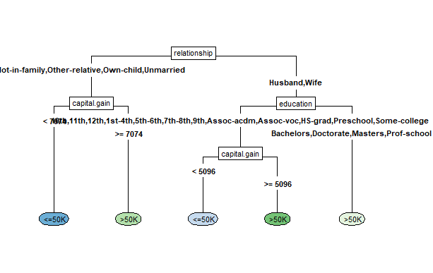
Decision Tree

Slide 27
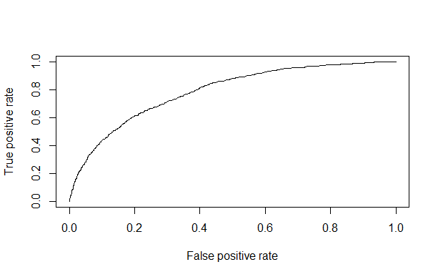
Confusion Matrix

Slide 28
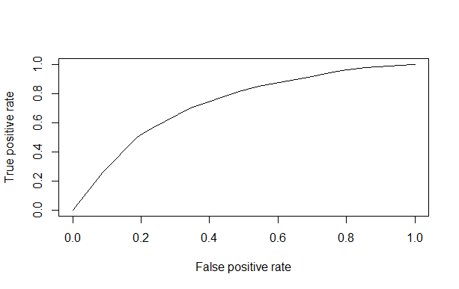
Confusion Matrix

Slide 29
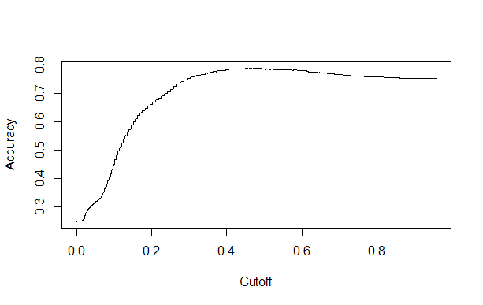
Confusion Matrix

Slide 30
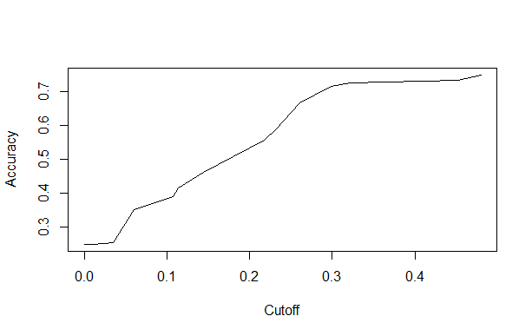
Confusion Matrix

Slide 31
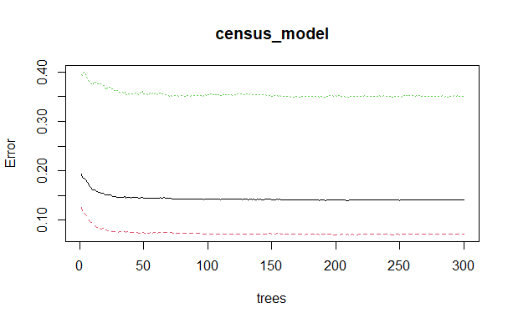
Confusion Matrix

